Slide 1
Recurrent Neural Networks
OPER 785: Machine Learning II: Deep Learning
Lecture 09

Slide 2
Learning Objectives
At the end of the lecture the student will….
understand what an RNN is and when to use it
understand different RNN designs, and how to correct problems
understand methods to train and use RNNs
Notes:
I plan on utilizing the Hands On Book for the Coding Examples
https://github.com/ageron/handson-ml2/blob/master/15_processing_sequences_using_rnns_and_cnns.ipynb

Slide 3
Overview
Motivation
Concept
Input and Output Sequences
Common RNNs
Code

Slide 4
Vocabulary
Sequence-to-Sequence Network
Sequence to Vector Network
Vector-to-Sequence Network
Backpropagation through time
Encoder
Decoder
Encoder-Decoder
Imputation
Memory
Memory cell
Time step (frame)
Recurrent network
Unrolling the network through time
Time series
Univariate time series
Multivariate time series

Slide 5
Motivation
some people made a neural network
without order
a neural network made some people

Slide 6
Overview
Motivation
Background
Concepts
Vanilla RNN
Unstable Gradient Problem
LSTM
GRU

Slide 7
Motivation
Single Data Point

Slide 8
Motivation
Single Data Point
Sequential Data

Slide 9
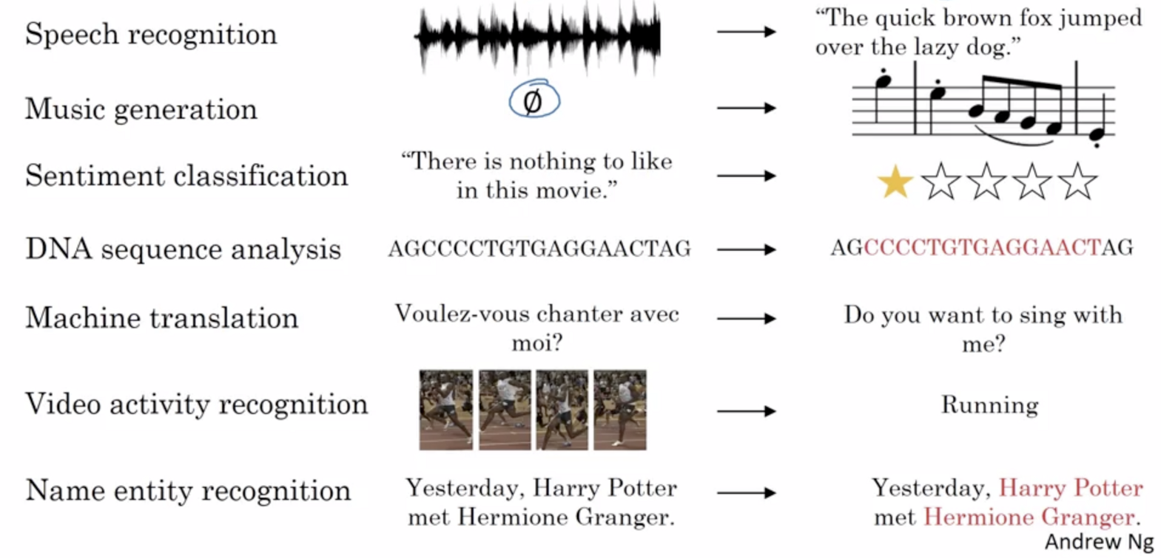

Example Sequence Models
X and Y can have different lengths. We will learn which Sequence Models are applicable to these different applications
Notes:
From Coursera Dr. Ng: Models like recurrent neural networks or RNNs have transformed speech recognition,
natural language processing and other areas.
Let's start by looking at a few examples of where sequence models can be useful.
In speech recognition you are given
an input audio clip X and asked to map it to a text transcript Y.
Both the input and the output here are sequence data,
because X is an audio clip and so that plays out over time and Y,
the output, is a sequence of words. (Sequence to Sequence)
So sequence models such as a recurrent neural networks and other variations,
you'll learn about in a little bit have been very useful for speech recognition.
Music generation is another example of a problem with sequence data.
In this case, only the output Y is a sequence,
the input can be the empty set,
or it can be a single integer,
maybe referring to the genre of music you want to
generate or maybe the first few notes of the piece of music you want.
But here X can be nothing or maybe just an integer and output Y is a sequence.
In sentiment classification the input X is a sequence,
so given the input phrase like,
"There is nothing to like in this movie" how many stars do you think this review will be?
Sequence models are also very useful for DNA sequence analysis. (Sequence to Vector)?
So your DNA is represented via the four alphabets A, C, G,
and T. And so given a DNA sequence can you label
which part of this DNA sequence say corresponds to a protein.
In machine translation you are given an input sentence,
voulez-vou chante avec moi? Sequence-to-Sequence
And you're asked to output the translation in a different language.
In video activity recognition you might be given
a sequence of video frames and asked to recognize the activity. (Sequence-to-Vector?)
And in name entity recognition you might be given
a sentence and asked to identify the people in that sentence.
So all of these problems can be addressed as supervised learning with label data X,
Y as the training set.
But, as you can tell from this list of examples,
there are a lot of different types of sequence problems.
In some, both the input X and the output Y are sequences,
and in that case,
sometimes X and Y can have different lengths,
or in this example and this example,
X and Y have the same length.
And in some of these examples only either X or only the opposite Y is a sequence.

Slide 10
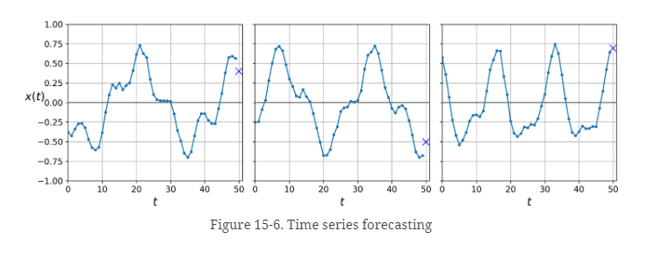
Forecasting a Time Series
Time series: data in a sequence of one or more values per time step
Forecasting: predicting future values
Notes:
Could be stocks price. Historical data can be used to make future predictions

Slide 11
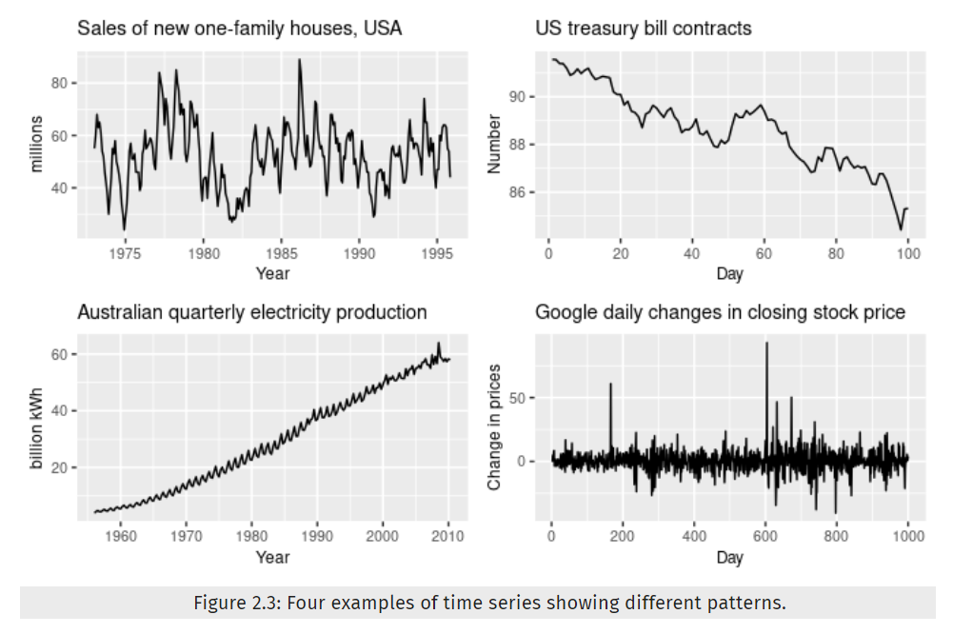
Time Series Patterns
Notes:
Top Left: Seasonality
Top right:Downward trend
Bottom Left: upward trend with seasonality
Bottom right: no trend or seasonality , besides what seem to be random fluctuations.
It is more important to notice these trends in other Time Series models such as ARIMA, it is generally not necessary to do all this, but it may improve performance in some cases, since the model will not have to learn the trend or the seasonality.

Slide 12
Examples of Sequence Model Applications
X and Y can have different lengths. We will learn which Sequence Models are applicable to these different applications
Notes:
From Coursera Dr. Ng: Models like recurrent neural networks or RNNs have transformed speech recognition,
natural language processing and other areas.
Let's start by looking at a few examples of where sequence models can be useful.
In speech recognition you are given
an input audio clip X and asked to map it to a text transcript Y.
Both the input and the output here are sequence data,
because X is an audio clip and so that plays out over time and Y,
the output, is a sequence of words. (Sequence to Sequence)
So sequence models such as a recurrent neural networks and other variations,
you'll learn about in a little bit have been very useful for speech recognition.
Music generation is another example of a problem with sequence data.
In this case, only the output Y is a sequence,
the input can be the empty set,
or it can be a single integer,
maybe referring to the genre of music you want to
generate or maybe the first few notes of the piece of music you want.
But here X can be nothing or maybe just an integer and output Y is a sequence.
In sentiment classification the input X is a sequence,
so given the input phrase like,
"There is nothing to like in this movie" how many stars do you think this review will be?
Sequence models are also very useful for DNA sequence analysis. (Sequence to Vector)?
So your DNA is represented via the four alphabets A, C, G,
and T. And so given a DNA sequence can you label
which part of this DNA sequence say corresponds to a protein.
In machine translation you are given an input sentence,
voulez-vou chante avec moi? Sequence-to-Sequence
And you're asked to output the translation in a different language.
In video activity recognition you might be given
a sequence of video frames and asked to recognize the activity. (Sequence-to-Vector?)
And in name entity recognition you might be given
a sentence and asked to identify the people in that sentence.
So all of these problems can be addressed as supervised learning with label data X,
Y as the training set.
But, as you can tell from this list of examples,
there are a lot of different types of sequence problems.
In some, both the input X and the output Y are sequences,
and in that case,
sometimes X and Y can have different lengths,
or in this example and this example,
X and Y have the same length.
And in some of these examples only either X or only the opposite Y is a sequence.

Slide 13
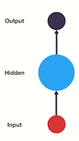
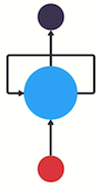
The Concept
Feedforward NN
Recurrent NN

Slide 14
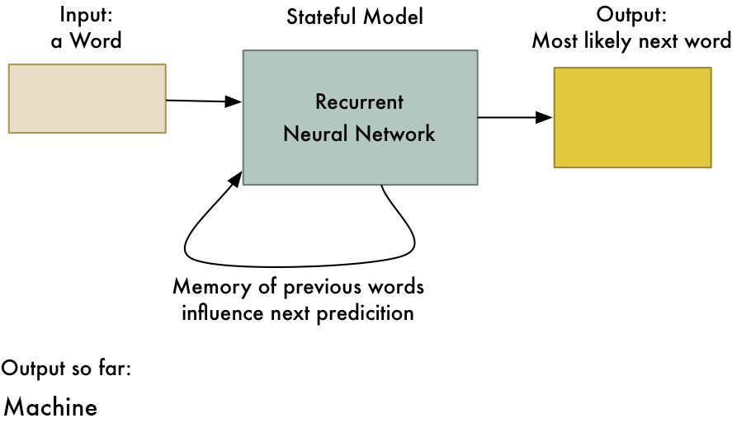
The Concept

Slide 15
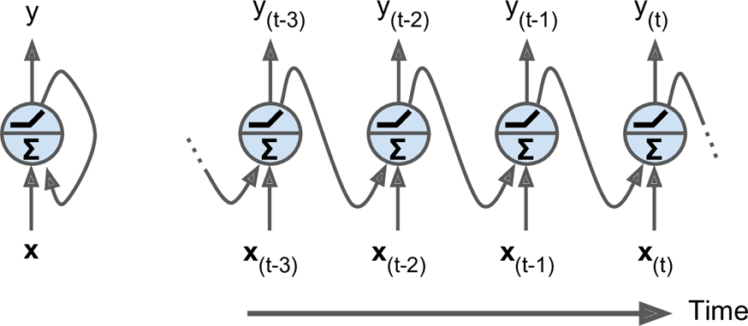
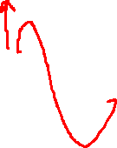
Recurrent Neurons
Recurrent Neuron
Network Unrolled through Time
Notes:
Page 498 – Figure 15-1: A recurrent neuron (left) unrolled through time.
Unrolling the network through time

Slide 16
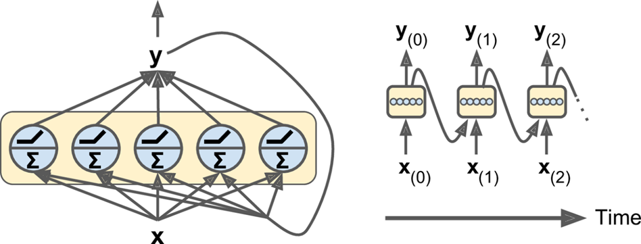
Recurrent Layers
Layer of
Recurrent Neurons
Network Unrolled
through Time
Notes:
Page 499 – Figure 15-2: A layer of recurrent neurons (left) unrolled through time (right)

Slide 17
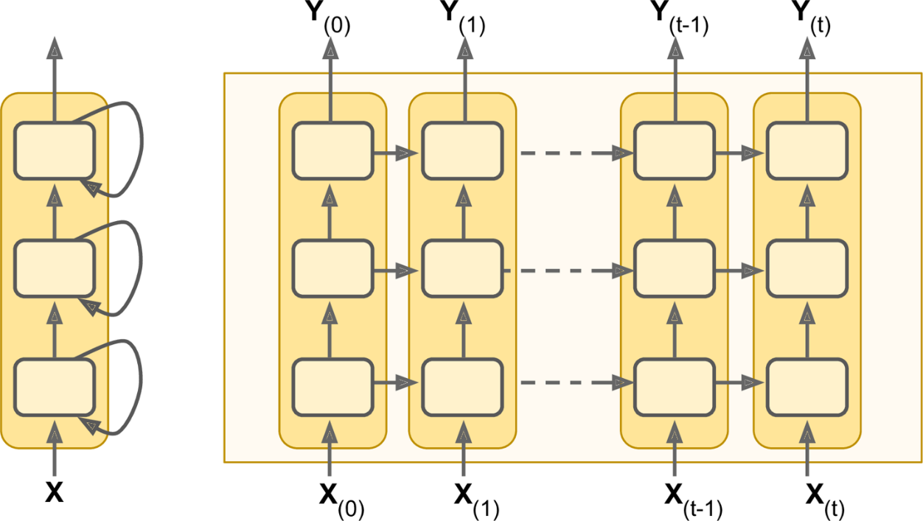
Deep RNNs

Slide 18
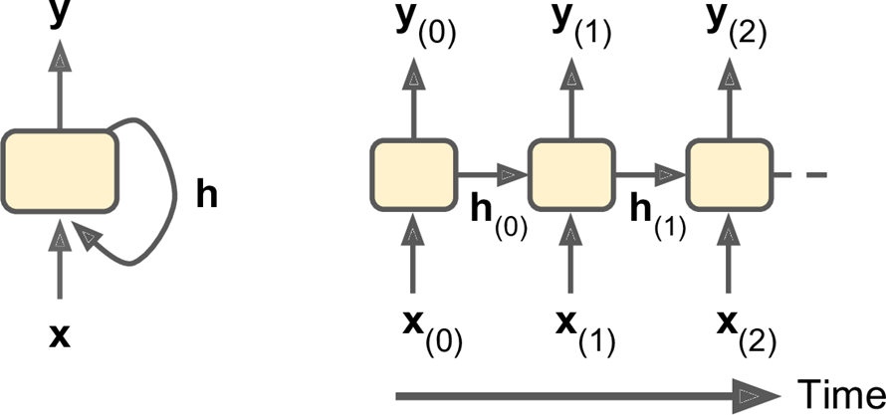
Memory Cells
Recurrent Neuron
Hidden State
Network Unrolled
through Time

Slide 19
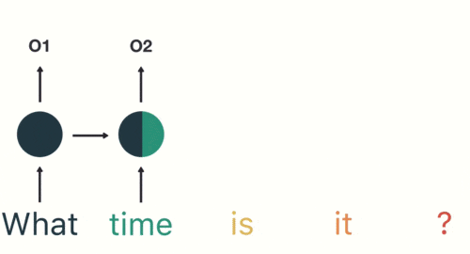
RNN Memory
https://towardsdatascience.com/illustrated-guide-to-recurrent-neural-networks-79e5eb8049c9#:~:text=And%20that's%20essentially%20what%20a,one%20step%20to%20the%20next.&text=This%20information%20is%20the%20hidden,a%20representation%20of%20previous%20inputs.

Slide 20
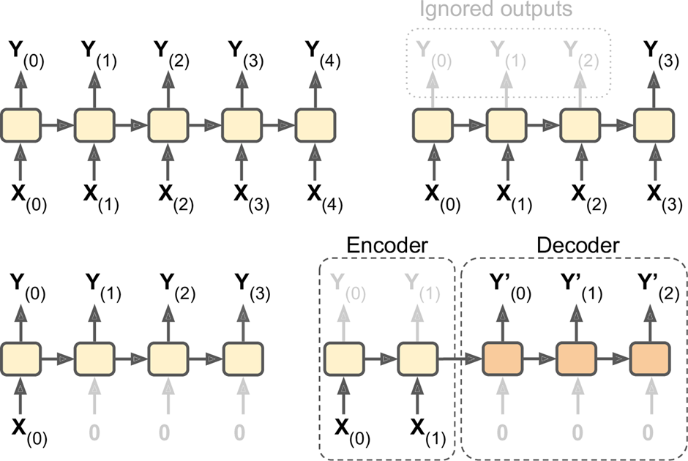
Input and Output Sequences

Slide 21

Sequence-to-Sequence Networks
Notes:
Useful for predicting time series such as stock prices, you put in the data from the last N days, and it will output the prices shifted by one day into the future. Also weather forecasts.

Slide 22
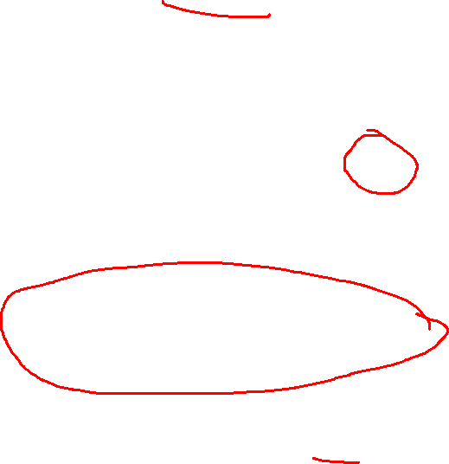
Sequence-to-Vector Networks

Slide 23
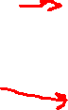
Vector-to-Sequence Networks
Notes:
You could feed the network the same thing over and over again and get output ; like feeding in picture and getting a caption for the image.

Slide 24
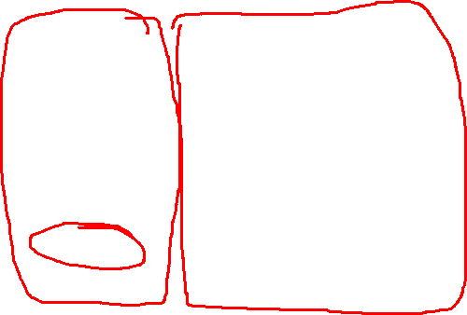
Encoder-Decoder Networks
Notes:
Lastly you could have a sequence to vector network called an Encoder followed by a Vector to sequence network called a Decorder. This is used for translating sentences from one language to another. This is more accurate than trying to translate on the fly. Chapter 16 is about Encoder-Decorders. And it is more complex than the picture suggest.s SO HOW DO YOU TRAIN A RNN

Slide 25
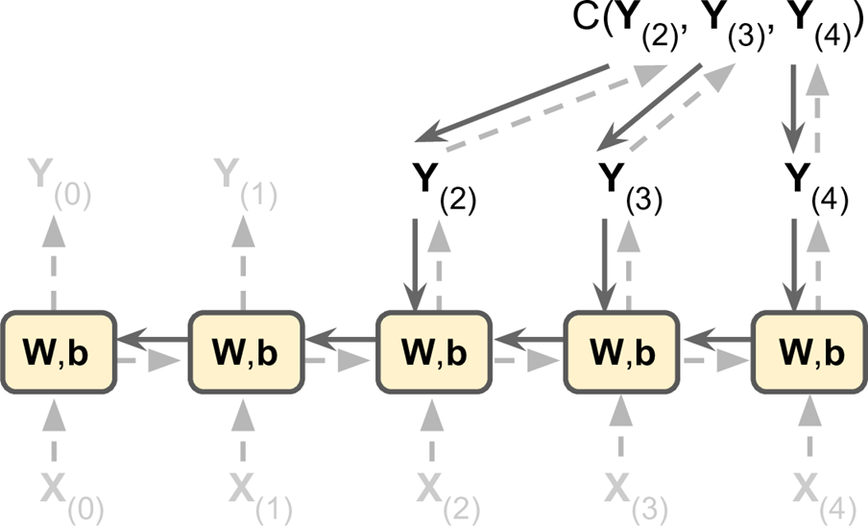
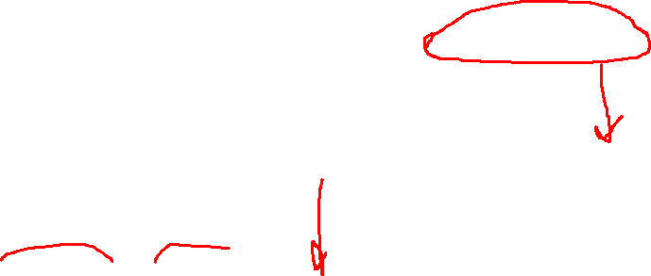
Training RNNs
Backpropogation through time (BPTT)

Slide 26
Most Common RNNs
“Vanilla” RNN
Long Short-term Memory (LSTM)
Gated Recurrent Units (GRU)
Bidirectional RNNs

Slide 27
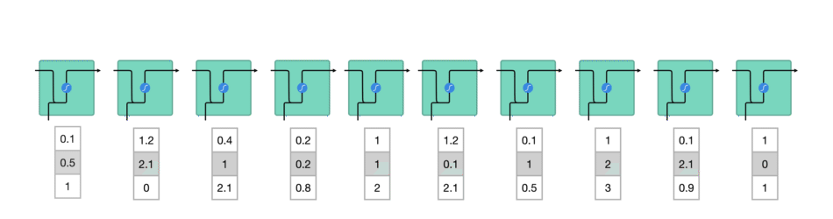
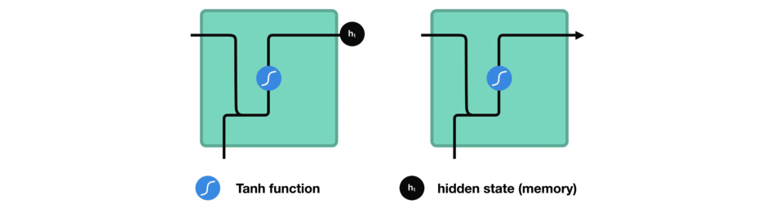
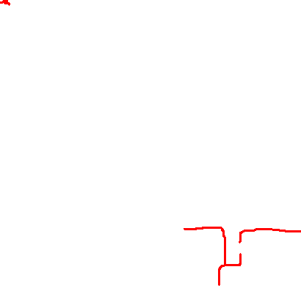
Vanilla RNN
Closer Look:

Slide 28
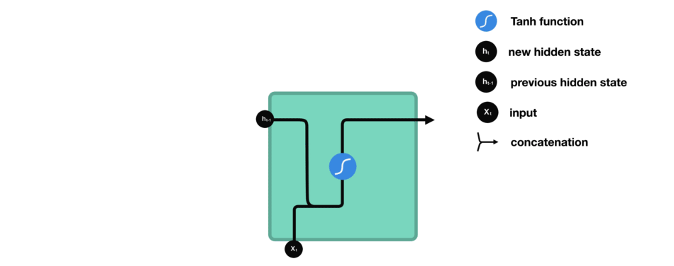
Even Closer Look (Vanilla RNN)

Slide 29
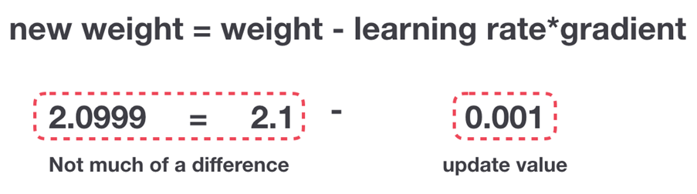
Vanishing Gradient Problem
During BPTT, RNNs suffer from the vanishing gradient problem.

Slide 30
Short-term Memory

Slide 31
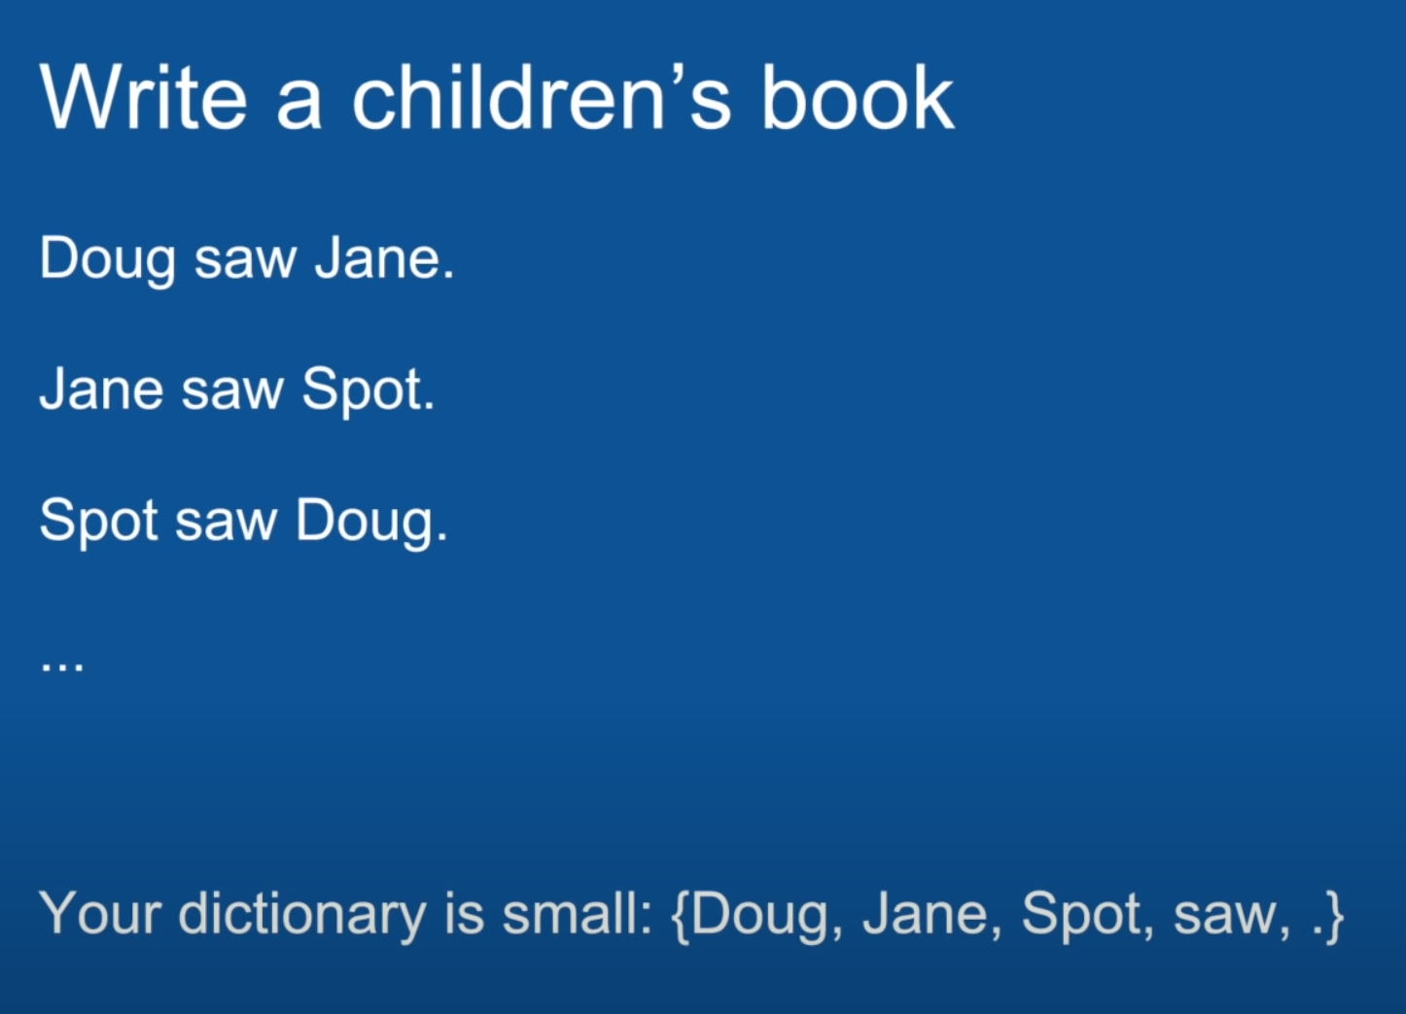
Short-term Memory Example

Slide 32
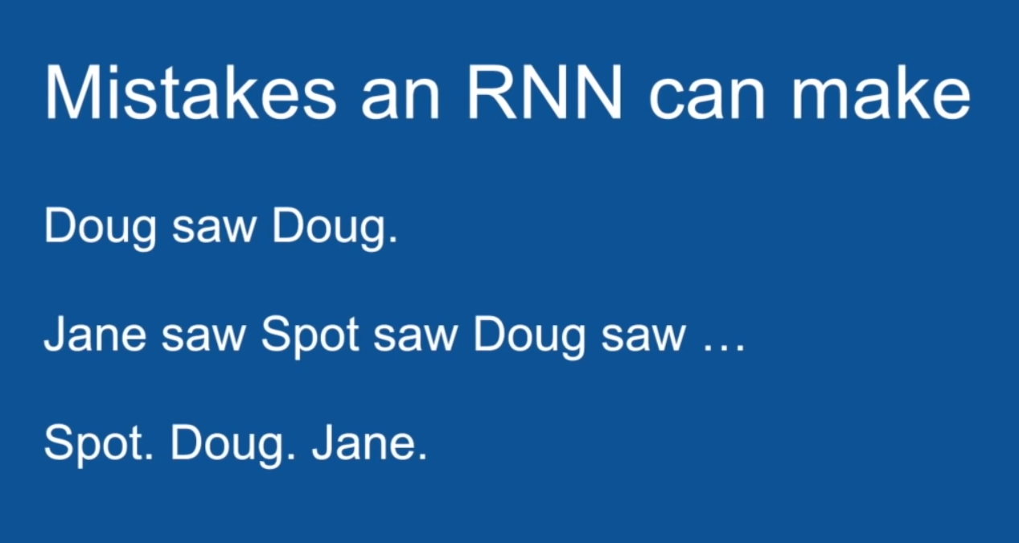
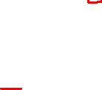
Short-term Memory Example

Slide 33
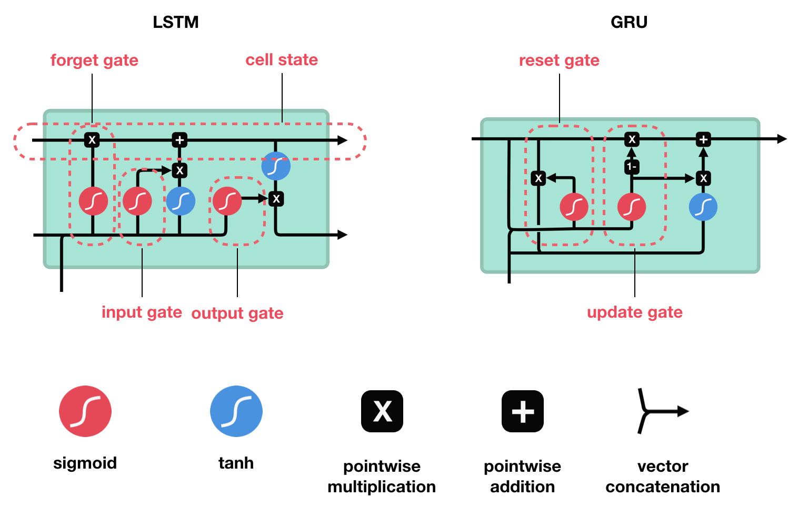
Solution!
Vanilla RNN
LSTM
GRU
LSTM’s and GRU’s essentially function just like RNN’s, but they’re capable of learning long-term dependencies using mechanisms called “gates.” ¹

Slide 34
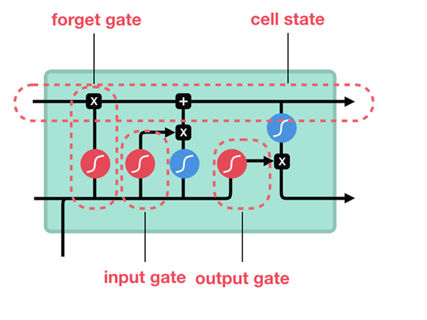
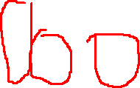
Long Short-Term Memory (LSTM)
Cell state
transfers relative information all the way down the sequence chain
Gates
decide which information is allowed in the cell state
Contain sigmoid activations
Forget Gate
Input Gate
Output Gate

Slide 35
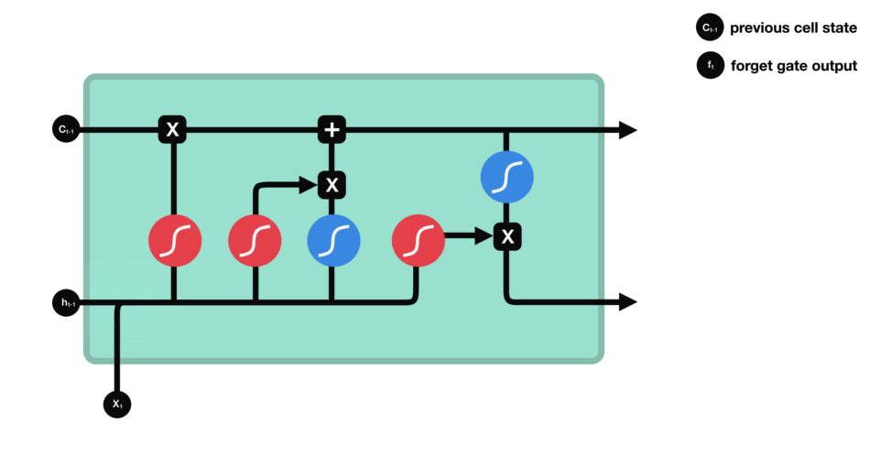
LSTM: Forget Gate
Decides what information should be kept or tossed
Notes:
Values closer to 0 mean forget and closer to one means 1

Slide 36
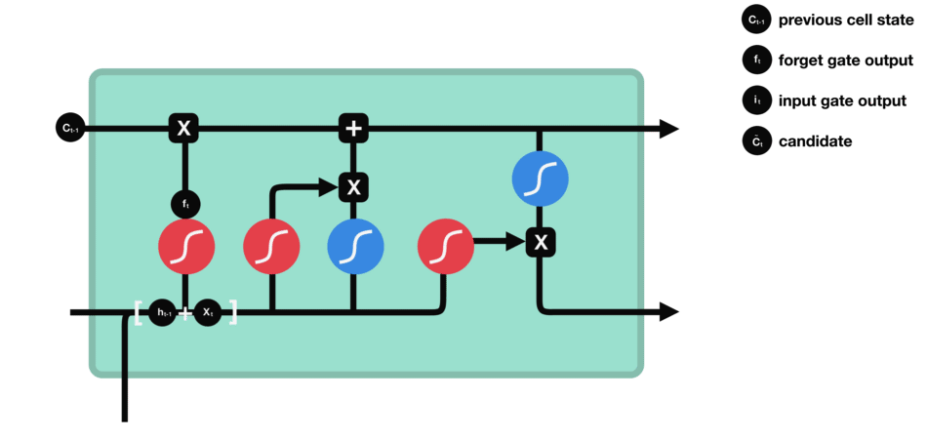
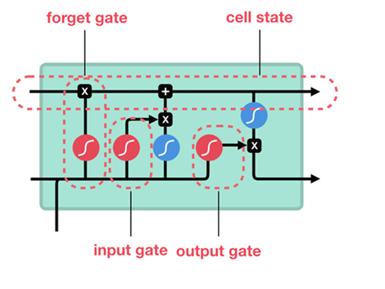
LSTM: Input Gate
Updates the cell state
Notes:
0 not important and 1 means important – squish values between -1 and 1 . Sigmoid keeps input from the Tan output

Slide 37
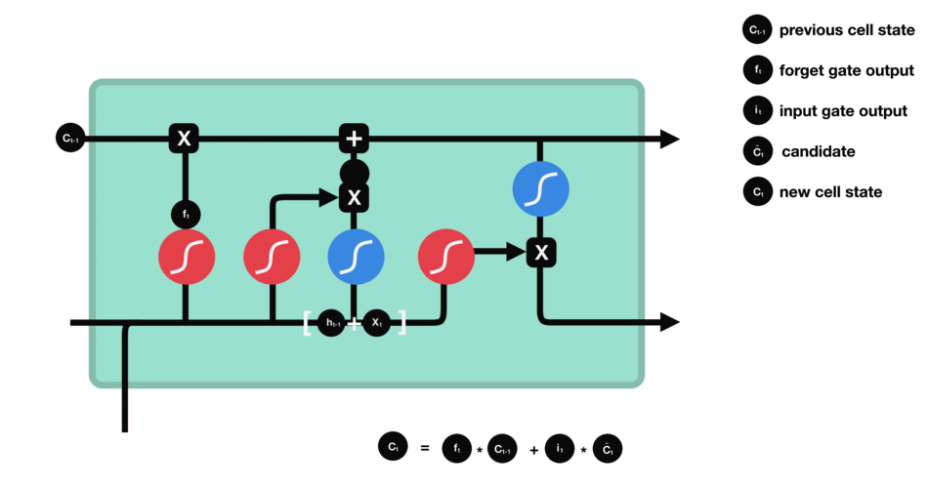
LSTM: Cell State
Contains the cell state

Slide 38

LSTM: Output Gate
Decides what the next hidden state should be
Notes:
Carried over to the next time step

Slide 39
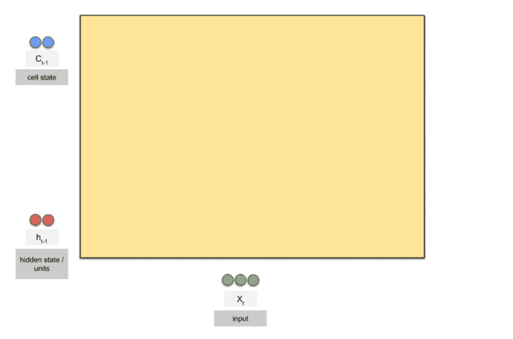
LSTM

Slide 40
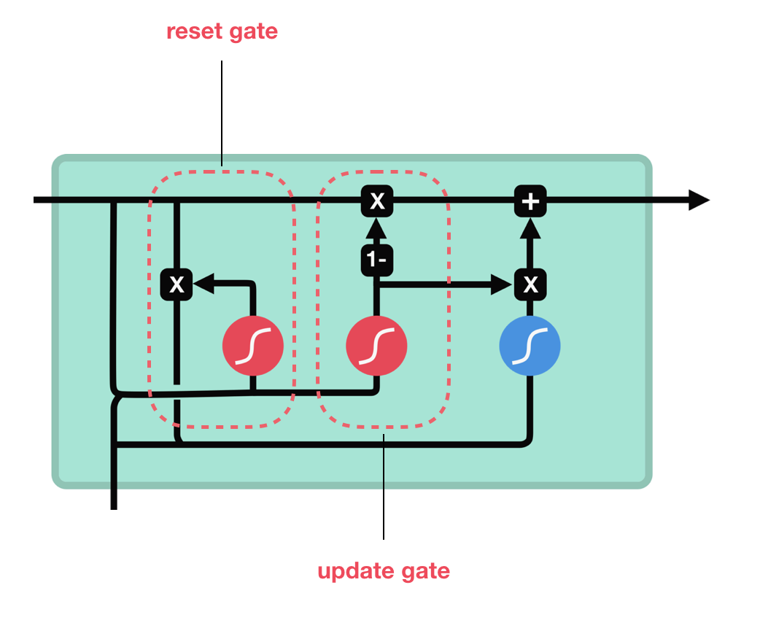
Gated Recurrent Unit (GRU)
No cell state!
Gates
Update Gate
Reset Gate
Notes:
Is a simplified newer version of LSTM, reset = how much past information gets forgotten. Update gate is the Forget and Input Gate, if something is to be updated, the previous data in that spot is overwritten. There is no output gate, the full state vector is output at every time step. GRU was introduced in same paper that introduced encoder and decoders.

Slide 41
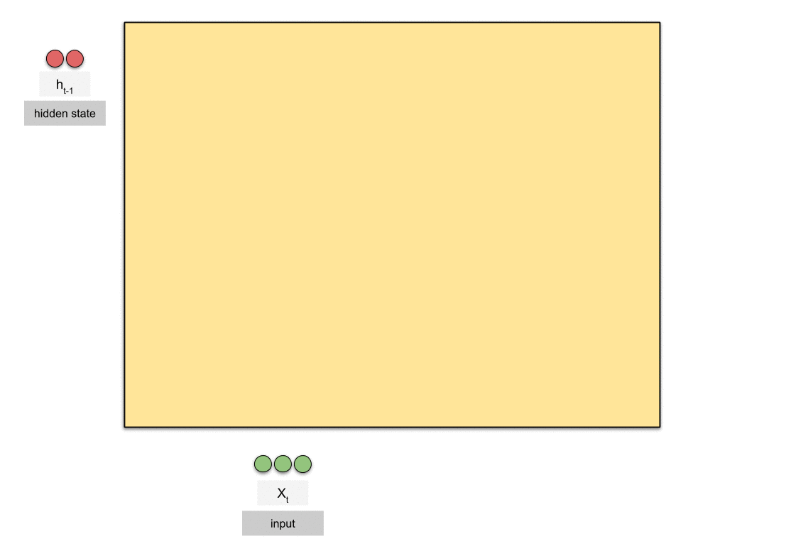
GRU

Slide 42
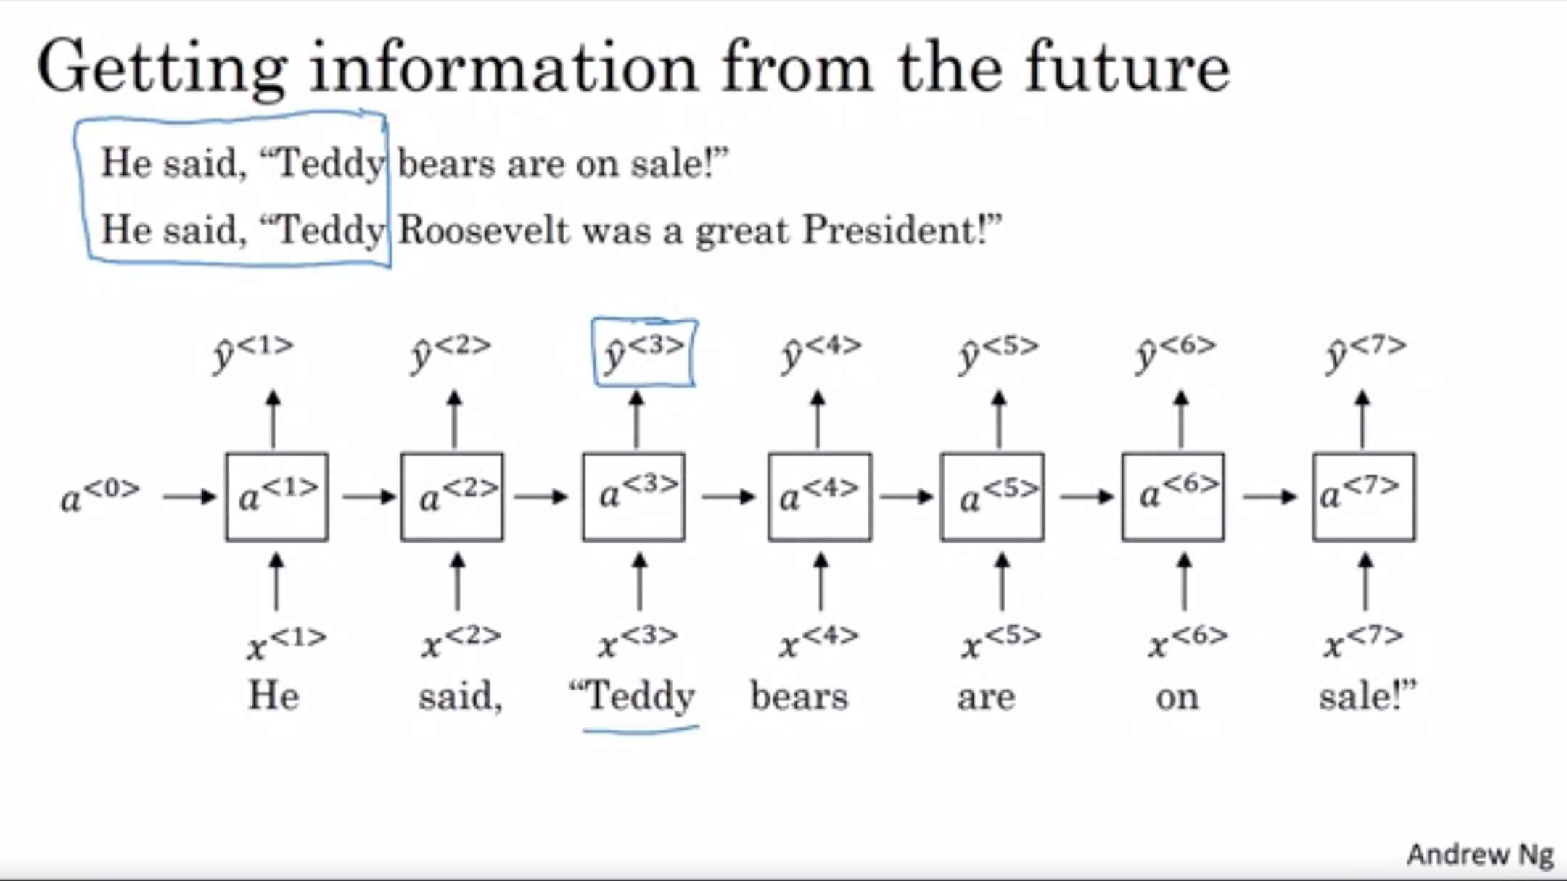
Bidirectional RNNs (BRNN)
Getting information from the future

Slide 43
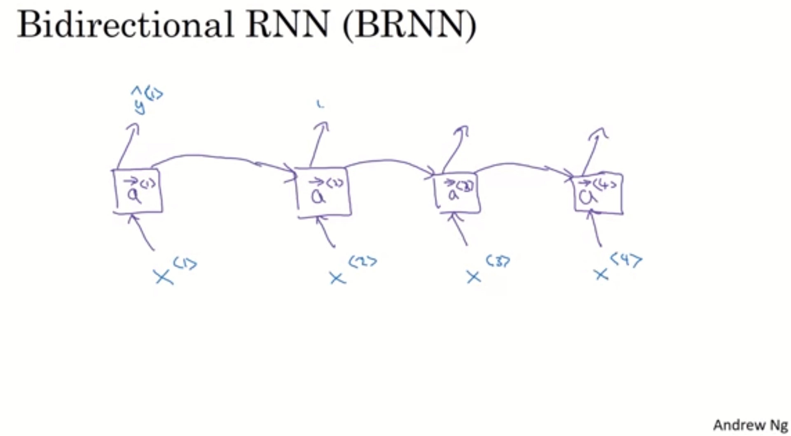
Bidirectional RNNs (BRNN)
Getting information from the future
A good place to start for NLPs is Bidirectional RNNs with LSTM. However, BRNN needs the entire sequence before you can process. This wouldn’t work for real-time speech to text recognition

Slide 44
Summary
RNNs are good for processing sequence data for predictions but suffers from short-term memory.
The short-term memory issue for vanilla RNN’s doesn’t mean to skip them entirely and use the more evolved versions like LSTM’s or GRU’s. RNN’s have the benefit of training faster and uses less computational resources.
You should use LSTM’s or GRU’s when you expect to model longer sequences with long-term dependencies.

Slide 45
Sources
https://www.youtube.com/watch?v=UNmqTiOnRfg
https://www.youtube.com/watch?v=LHXXI4-IEns
[1] https://towardsdatascience.com/illustrated-guide-to-recurrent-neural-networks-79e5eb8049c9#:~:text=And%20that's%20essentially%20what%20a,one%20step%20to%20the%20next.&text=This%20information%20is%20the%20hidden,a%20representation%20of%20previous%20inputs.
https://towardsdatascience.com/animated-rnn-lstm-and-gru-ef124d06cf45
https://towardsdatascience.com/illustrated-guide-to-lstms-and-gru-s-a-step-by-step-explanation-44e9eb85bf21
Brandon Rohrer. https://www.youtube.com/watch?v=WCUNPb-5EYI&t=1279s (Uses the cooking roommate example, and writing a story: Jane saw Doug…)
https://github.com/ageron/handson-ml2/blob/master/15_processing_sequences_using_rnns_and_cnns.ipynb
https://www.analyticsvidhya.com/blog/2019/01/fundamentals-deep-learning-recurrent-neural-networks-scratch-python/
Brandon Rohrer. How Backpropagation Works. https://end-to-end-machine-learning.teachable.com/courses/how-deep-neural-networks-work/lectures/11733744
Brandon Rohrer. How Recurrent Neural Networks (RNNs) and Long-Short-Term-Network Work. https://youtu.be/WCUNPb-5EYI Explains RNN clearly and good notation. Covers squashing function and memory.

Slide 46
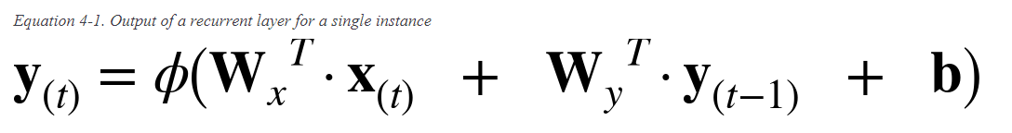
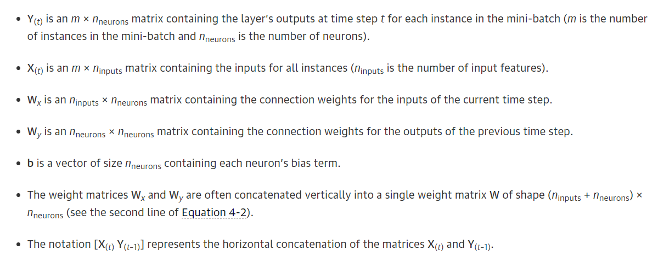
Calculations

Slide 47
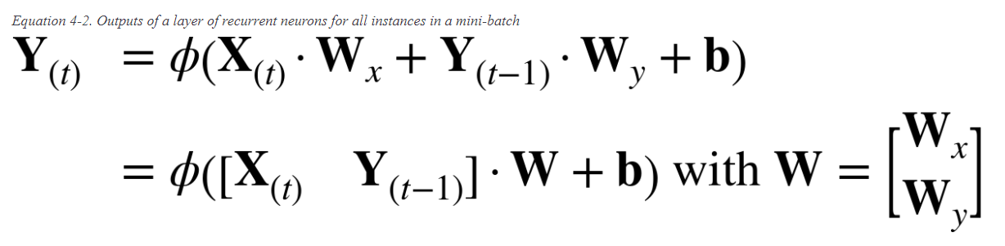
Calculations

Slide 48
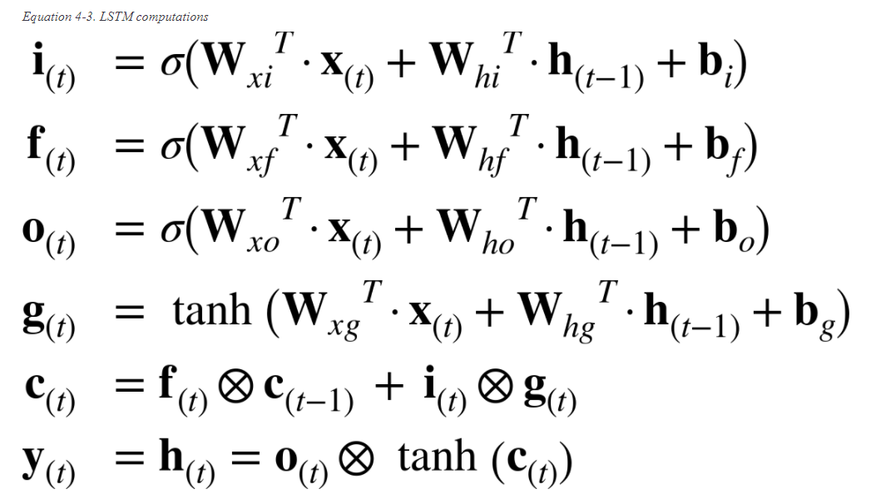
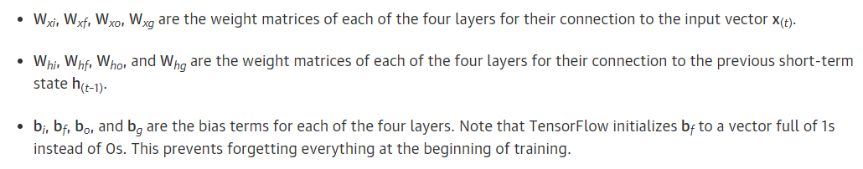
Calculations

Slide 49
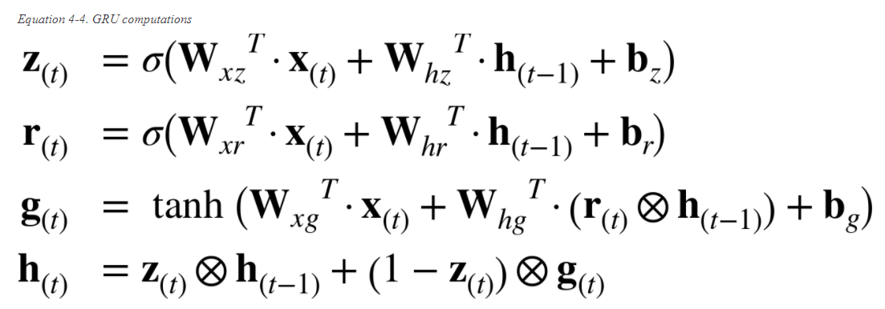
Calculations

Slide 50
Questions

